Slide 1


Noida Institute of Engineering and Technology, Greater Noida
Symbol Table
Unit: 4
Compiler Design
Rohit Chaudhary
Assistant Professor
CSE
Course Details (B Tech 5th Sem)

Slide 2
Brief Introduction of Faculty
Rohit Chaudhary
Designation: Assistant Professor CSE Department
NIET Grater Noida
Qualifications:
B.Tech from GBTU in 2010
M.Tech (CSE) from Galgotias University in 2013
Teaching Experinces : 08
Research Publications:
Particulars | Journals (UGC) | Conference(IEEE)
International | 02 | 01
National | 01

Slide 3
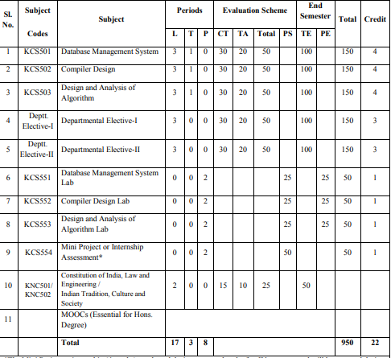
Evaluation Scheme

Slide 4
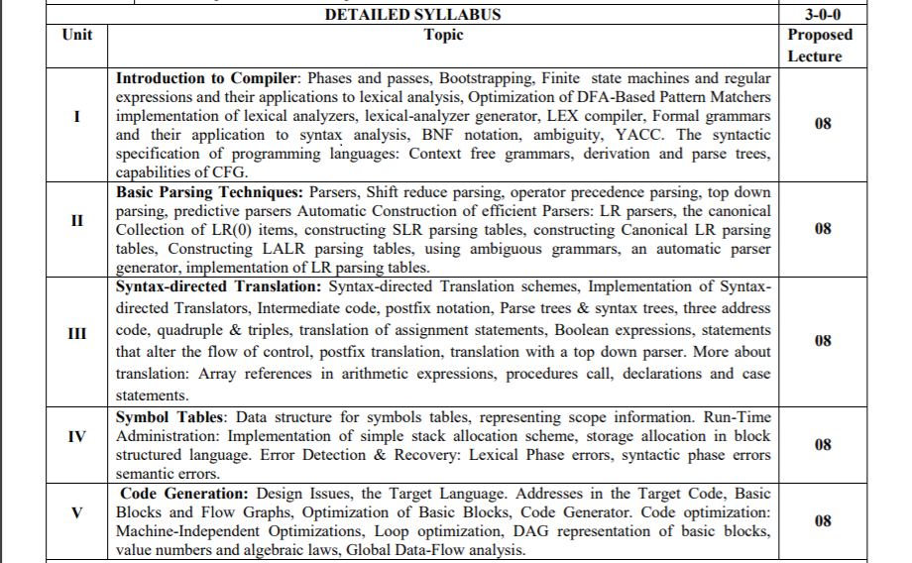
Syllabus

Slide 5
Branch Wise Application
Computer Science/ IT
Compiler technology can be used to translate the binary code for one machine to that of another, allowing a machine to run programs originally compiled for another instruction set. Binary translation technology has been used by various computer companies to increase the availability of software for their machines
Implementations of High Level Programming
Optimization of Computer Architecture
Design of New Computer Architecture
Program Translation
Software Productive tools

Slide 6
Course Objective
To learn the process of translating a modern high-level language to executable code.
To provide a student with an understanding of the fundamental principles in compiler design and to provide the skills needed for building compilers for various situations that one may encounter in a career in Computer Science.
To understand the machine dependent code
To draw the flow graph for the intermediate codes.
To apply the code generation algorithms to get the machine code for the optimized code
To apply the optimization techniques to have a better code for code generation

Slide 7
Course Outcome
CO-1 Acquire knowledge of different phases and passes of the compiler and also able to use the compiler tools like LEX, YACC, etc. Students will also be able to design different types of compiler tools to meet the requirements of the realistic constraints of compilers.
CO-2 Understand the parser and its types i.e. Top-Down and Bottom-up parsers and construction of LL, SLR, CLR, and LALR parsing table.
CO-3 Implement the compiler using syntax-directed translation method and get knowledge about the synthesized and inherited attributes.
CO-4 Acquire knowledge about run time data structure like symbol table organization and different techniques used in that.
CO-5 Understand the target machine’s run time environment, its instruction set for code generation and techniques used for code optimization.

Slide 8
Program Outcomes (PO)
PO1: Engineering Knowledge
PO2: Problem Analysis
PO3: Design/Development of solutions
PO4: Conduct Investigations of complex problems
PO5: Modern tool usage
PO6: The engineer and society
PO7: Environment and sustainability
PO8: Ethics
PO9: Individual and team work
PO10: Communication
PO11: Project management and finance
PO12: Life-long learning

Slide 9
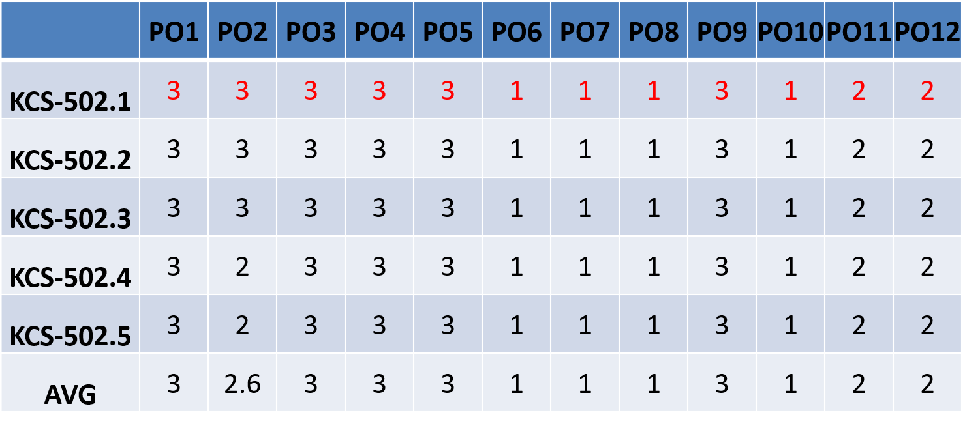
CO-PO Mapping

Slide 10
Program Specific Outcomes (PSO)
PSO1: Work as a software developer, database administrator, tester or networking engineer for providing solutions to the real world and industrial problems
PSO2:Apply core subjects of information technology related to data structure and algorithm, software engineering, web technology, operating system, database and networking to solve complex IT problems.
PSO 3:Practice multi-disciplinary and modern computing techniques by lifelong learning to establish innovative career.
PSO 4:Work in a team or individual to manage projects with ethical concern to be a successful employee or employer in IT industry

Slide 11
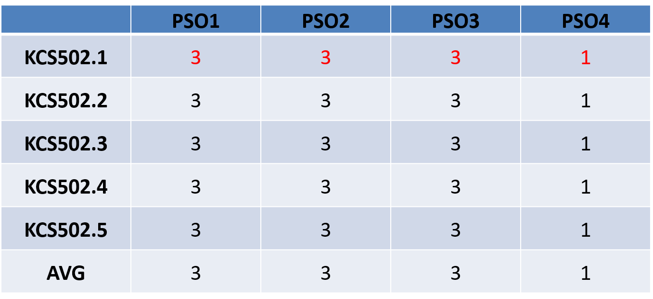
CO-PSO Mapping

Slide 12
Program Educational Objectives
PEO1: To have an excellent scientific and engineering breadth so as to
comprehend, analyze, design and provide sustainable solutions for
real-life problems using state-of-the-art technologies.
PEO2:To have a successful career in industries, to pursue higher studies or
to support entrepreneurial endeavors and to face global challenges.
PEO3:To have an effective communication skills, professional attitude,
ethical values and a desire to learn specific knowledge in emerging
trends, technologies for research, innovation and product
development and contribution to society.
PEO4: To have life-long learning for up-skilling and re-skilling for
successful professional career as engineer, scientist, entrepreneur
and bureaucrat for betterment of society

Slide 13
Result Analysis
Subject Result: 97.38 %
Department Result: 97.38 %
Faculty-Wise Result:
Ms. Megha Bharadwaj(B): 93.94%
Ms. Megha Bharadwaj(C): 97.01%
Ms. Ratna Patil(A): 98.48%
Ms. Ratna Patil(D): 100%

Slide 14
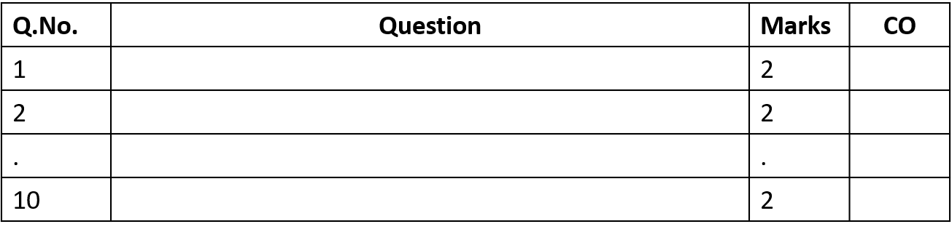
End Semester Question Paper Template
B TECH
(SEM-V) THEORY EXAMINATION 20__-20__
COMPILER DESIGN
Time: 3 Hours Total Marks: 100
Note: 1. Attempt all Sections. If require any missing data; then choose suitably.
SECTION A
Attempt all questions in brief. 2 x 10 = 20

Slide 15
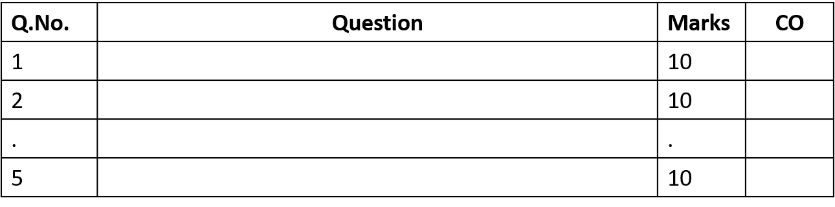
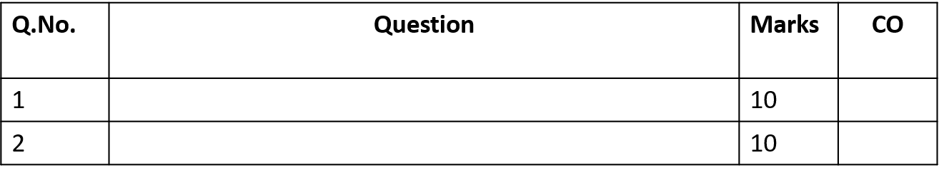
End Semester Question Paper Templates
SECTION B
2. Attempt any three of the following: 3 x 10 = 30
SECTION C
3. Attempt any one part of the following: 1 x 10 = 10

Slide 16
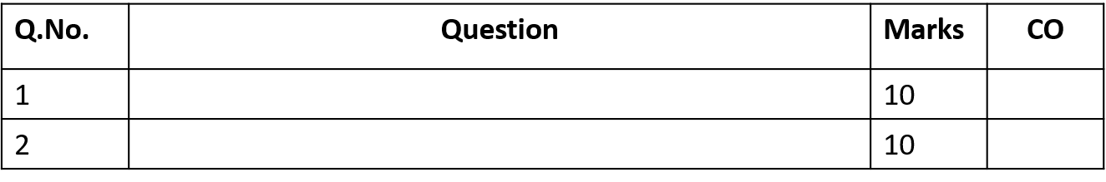
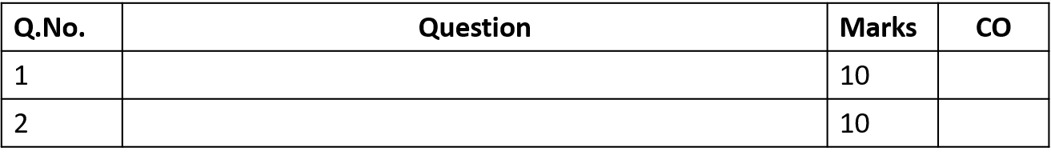
End Semester Question Paper Templates
4. Attempt any one part of the following: 1 x 10 = 10
5. Attempt any one part of the following: 1 x 10 = 10
6. Attempt any one part of the following: 1 x 10 = 10

Slide 17
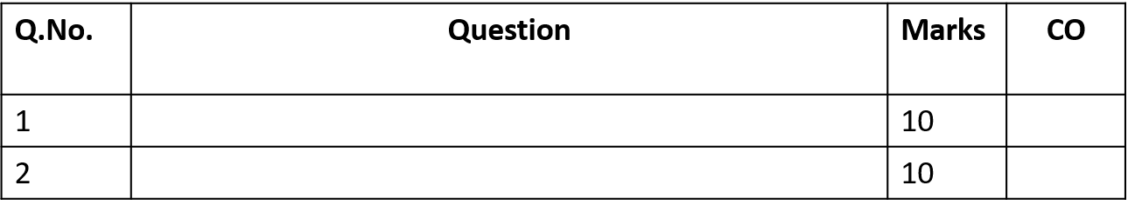
End Semester Question Paper Templates
7. Attempt any one part of the following: 1 x 10 = 10

Slide 18
Prerequisite
.
Automata Theory
Context Free Languages
Data Structure
Logic or Algebra
Simple Graph Algorithms
Computer Architecture

Slide 19
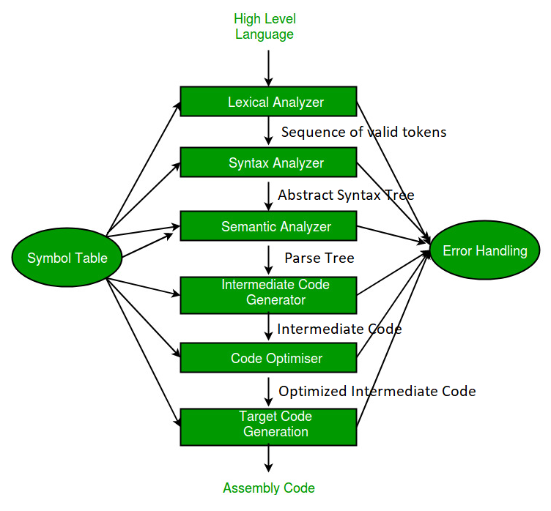
RECAP
Analysis
(Frontend)
Synthesis
(Backend)

Slide 20
Brief Introduction about the Subject with video
Compiler design principles provide an in-depth view of translation and optimization process. Compiler design covers basic translation mechanism and error detection & recovery. It includes lexical, syntax, and semantic analysis as front end, and code generation and optimization as back-end.
https://youtu.be/Qkwj65l_96I
https://youtu.be/WccZQSERfCM
https://youtu.be/j-bLeUysUiE

Slide 21
Unit Content
Symbol Tables
Data structure for symbol tables
Representing scope information
Run-Time Administration
Implementation of simple stack allocation scheme
Storage allocation in block structured language
Error Detection and Recovery
Lexical phase errors
Syntactic phase errors
Semantic errors

Slide 22
Objective of Topic
Topic | Objective
Symbol Table | To understand the working of symbol table with different phases.
Run-Time Administration: | Understand the logic behind run time administration.
Implementation of simple stack allocation scheme, | To learn about different algorithm for implementing different allocation scheme i.e. stack allocation
Storage allocation in block structured language. | To understand the different types of storage allocation techniques.
Error Detection & Recovery: | To learn about different error detection and recovery method in lexical syntax and semantic analysis phases.

Slide 23
Symbol Table(CO4)
An important part of any compiler is the construction and maintenance of a dictionary containing names and their associated values, such type of dictionary is called a symbol table
The symbol tables - repository of all information within a compiler. All parts of a compiler communicate through these table and access the data-symbols. Symbol tables are also used to hold labels, constants, and types.

Slide 24
Symbol Table
Symbols are collected into symbol tables. The symbol-table module manages symbols and tables.
Symbol table store information about the occurrence of various entities such as: objects, classes, variable names, function etc.
It is used by both analysis phase and synthesis phases
Symbol Management should also deal with scope and visibility that is imposed by the language.

Slide 25
Operations of Symbol Table
The basic operations defined on a symbol table include:

Slide 26
Attributes of symbol table:
Name: Several alternatives are available for representing the name. symbol names may be: Fixed length and variable length
Information: The information field about a name may include the following attributes:
Type
Lifetime
Address
Size
Scope
Value
NAME | INFORMATION

Slide 27
Data Structure for Symbol table:
There are several data structure that is used in our symbol table, it including
Arrays
Linear lists
Search trees
Hash tables.

Slide 28
Data Structure for Symbol table:
Array:
An array is a collection of items stored at contiguous memory locations. The idea is to store multiple items of the same type together. An array data structure for symbol table is sub divided into two categories-
Unsorted array-New symbols are added to the end of the table. Searching for a symbol starts at the end and is linear. The most recent scope is always at the end of the table.
Sorted Array-In this data structure new symbols are inserted in sorted order. Binary search is used. It has no scope support

Slide 29
Data Structure for Symbol table:
Linear list:
Like an array, a linear list stores a collection of objects of a certain type, usually denoted as the elements of the list. The elements are ordered within the linear list in a linear sequence. Linear lists are usually simply denoted as lists.
The simplest and easiest to implement data structure for symbol table is a linear list of records.
Linear linked list
Self Organizing List:

Slide 30
Data Structure for Symbol table:
Linear linked list:
In this data structure new symbols are inserted at the front of the list or to the end of array.
End of array always marks by a point known as space.
When we insert any name in this list then searching is done in whole array from ‘space’ to beginning of array.
If word is not found in array then we create an entry at ‘space’ and increment ‘space’ by one or value of data type.

Slide 31
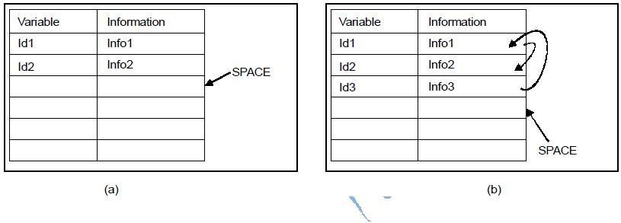
Data Structure for Symbol table:
2. Self Organizing List:
To reduce the time of searching we can add an addition field ‘linker’ to each record field or each array index. When a name is inserted then it will insert at ‘space’ and manage all linkers to other existing name.
Figure: symbol table for self organizing list

Slide 32
Data Structure for Symbol table:
Balanced search tree:
The structure of the tree represents the sorted order of the records.
In this data structure maintaining balance is important because of the tendency of programmers to use systematic names with common prefixes/suffixes.
It has no scope support; some problems as with sorted arrays.

Slide 33
Data Structure for Symbol table:
Hash table:
A hash function data structure for symbol table is sub divided into two categories;
1. Closed hash table:
2. Open hash table:

Slide 34
Data Structure for Symbol table:
Closed hash table: This data structure is an array of symbol table records inserted in a random order.
A hash function applied to the name determines the location in the table where the symbol record should be stored.
A collision resolution strategy must be employed to deal with name that hash to the same value.

Slide 35
Data Structure for Symbol table:
2. Open hash table:
A hash table, or a hash map, is a data structure that associates keys with values ‘Open hashing’ is a key that is applied to hash table.
This data structure is an array of pointers to linear linked lists of symbol table records.
All symbols that have the same name hash to the name list. Insert new most records at the start of the list.
It has good scope support; symbols in the most records recently entered scope are at the front of the list.

Slide 36
Representing Scope Information:
The scope of a name is the portion of the program over which it may be used or Each name possesses a region of validity within the source program called the scope of that name.
The rules governing the scope of names in a block-structured language are as follows:
A name declared within block B is valid only within B.
If block B1 is nested within B2, then any name that is valid for B2 is also valid for B1, unless identifier for that name is re-declared in B1.
These rules require a more complicated symbol table organization that simply a list of associations between names and attributes.

Slide 37
Representing Scope Information: (CO4)
One technique is to keep multiple symbol tables for each active block:
Each table is list of names and their associated attributes, and the tables are organized on stack.
Whenever a new block is entered, a new table is pushed on the stack.
When a declaration is compiled, the table on the stack is searched for the name.
If name is not found it is inserted.
When a reference is translated, it is searched in all tables starting from top.

Slide 38
Representing Scope Information:
Another technique is to represent scope information in the symbol table.
Store the nesting depth of each procedure block in the symbol table.
Use the (procedure name, nesting depth) pair as the key to accessing the information from the table.
The nesting depth of a procedure is a number that is obtained by starting with a value of one for the main and adding one to it every time we go from an enclosing to an enclosed procedure.
It counts the number of procedure in the referencing environment of a procedure.

Slide 39
Storage Organization
When the target program executes then it runs in its own logical address space in which the value of each program has a location.
The logical address space is shared among the compiler, operating system and target machine for management and organization.
The operating system is used to map the logical address into physical address which is usually spread throughout the memory.

Slide 41
Subdivision of Run-time Memory: (CO4)
Runtime storage comes into blocks, where a byte is used to show the smallest unit of addressable memory. Using the four bytes a machine word can form. Object of multibyte is stored in consecutive bytes and gives the first byte address.
Run-time storage can be subdivide to hold the different components of an executing program:
Generated executable code
Static data objects
Dynamic data-object- heap
Automatic data objects- stack

Slide 42
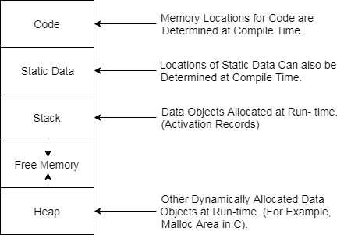
Subdivision of Run-time Memory:

Slide 43
Activation Record (CO4)
Control stack is a run time stack which is used to keep track of the live procedure activations i.e. it is used to find out the procedures whose execution have not been completed.
When it is called (activation begins) then the procedure name will push on to the stack and when it returns (activation ends) then it will popped.
Activation record is used to manage the information needed by a single execution of a procedure.
An activation record is pushed into the stack when a procedure is called and it is popped when the control returns to the caller function.

Slide 44
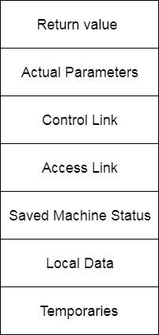
Activation Record
Return Value: It is used by called procedure to return a value to calling procedure.
Actual Parameter: It is used by calling procedures to supply parameters to the called procedures.
Control Link: It points to activation record of the caller.
Access Link: It is used to refer to non-local data held in other activation records.

Slide 45
Activation Record
Saved Machine Status: It holds the information about status of machine before the procedure is called.
Local Data: It holds the data that is local to the execution of the procedure.
Temporaries: It stores the value that arises in the evaluation of an expression.

Slide 46
Storage Allocation
The different ways to allocate memory are:
Static storage allocation
Stack storage allocation
Heap storage allocation

Slide 47
Static storage allocation
In static allocation, names are bound to same storage locations.
If memory is created at compile time then the memory will be created in static area and only once.
Static allocation supports the dynamic data structure that means memory is created only at compile time and deallocated after program completion.
The drawback with static storage allocation is that the size and position of data objects should be known at compile time.
Another drawback is restriction of the recursion procedure.

Slide 48
Stack Storage Allocation
In stack storage allocation, storage is organized as a stack.
An activation record is pushed into the stack when activation begins and it is popped when the activation end.
Activation record contains the locals so that they are bound to fresh storage in each activation record. The value of locals is deleted when the activation ends.
It works on the basis of last-in-first-out (LIFO) and this allocation supports the recursion process.

Slide 49
Heap Storage Allocation
Heap allocation is the most flexible allocation scheme.
Allocation and deallocation of memory can be done at any time and at any place depending upon the user's requirement.
Heap allocation is used to allocate memory to the variables dynamically and when the variables are no more used then claim it back.
Heap storage allocation supports the recursion process.

Slide 50
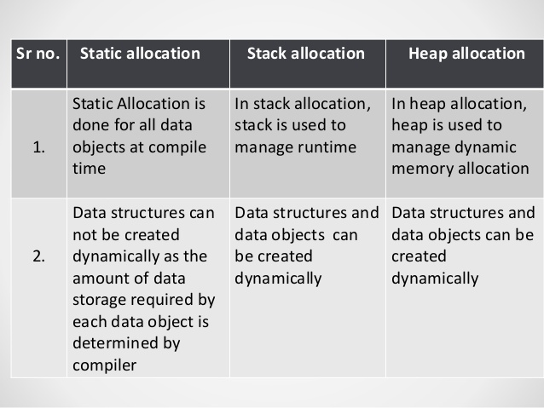
Difference between Static, Stack and Heap Allocation

Slide 51
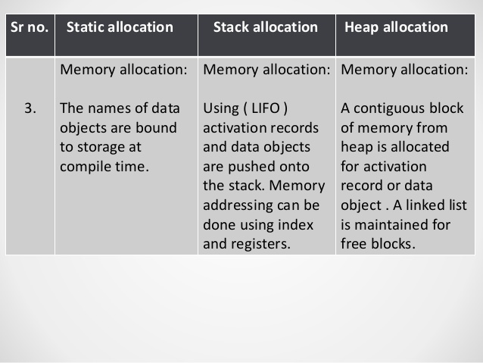
Difference between Static , Stack and Heap Allocation

Slide 52
Error Detection and Recovery (CO4)
ERROR-
Program submitted to a compiler often have errors of various kinds.
So, good compiler should be able to detect as many errors as possible in various ways and also recover from them (i.e) even in the presence of errors ,the compiler should scan the program and try to compile all of it.(error recovery).

Slide 53
Classification of Errors

Slide 54
Lexical Error (CO4)
This type of errors can be detected during lexical analysis phase. Typical lexical phase errors are:
Spelling errors. Hence get incorrect tokens.
Exceeding length of identifier or numeric constants.
Appearance of illegal characters
Ex: fi ( ) {…….. }
In above code 'fi' cannot be recognized as a misspelling of keyword if rather lexical analyzer will understand that it is an identifier and will return it as valid identifier. Thus misspelling causes errors in token formation.

Slide 55
Syntax Error (CO4)
This type of error appear during syntax analysis phase of compiler. Typical errors are:
Errors in structure
Missing operators
Unbalanced parenthesis
The parser demands for tokens from lexical analyzer and if the tokens do not satisfy the grammatical rules of programming language then the syntactical errors get raised.

Slide 56
Semantic Error (CO4)
This type of error detected during semantic analysis phase.
Typical errors are:
Incompatible types of operands
Undeclared variable
Not matching of actual argument with formal argument

Slide 57
Error recovery strategies OR Ad-hoc and systematic methods
Panic mode
Phrase level recovery
Error production
Global production

Slide 58
Panic Mode
Panic Mode strategy is used by most of the parsing methods. As this is simple to implement.
If error is been identified, the parser discard input symbol one at a time.
This process is continued until one of a designated set of synchronizing tokens is found.

Slide 59
Phrase level recovery
In this method, on discovering error parser performs local correction on remaining input.
It can replace a prefix of remaining input by some string. This actually helps parser to continue its job.
The local correction can be replacing comma by semicolon, deletion of semicolons or inserting missing semicolon; this type of local correction is decided by compiler designer.
While doing the replacement a care should be taken for not going in an infinite loop.
This method is used in many error-repairing compilers.

Slide 60
Error Production
If we have knowledge of common errors that can be encountered then we can incorporate these errors by augmenting the grammar of the corresponding language with error productions that generate the erroneous constructs.
If error production is used then during parsing, we can generate appropriate error message and parsing can be continued.
This method is extremely difficult to maintain. Because if we change grammar then it becomes necessary to change the corresponding productions.

Slide 61
Global Production
We often want such a compiler that makes very few changes in processing an incorrect input string.
We expect less number of insertions, deletions, and changes of tokens to recover from erroneous input.
Such methods increase time and space requirements at parsing time.
Global production is thus simply a theoretical concept.

Slide 62
Error recovery in Predictive Parsing
An error is detected during predictive parsing when:
The terminal on the top of the stack does not match the next input symbol.
When nonterminal A is on top of the stack a is the next input symbol and the parsing table entry M[A,a] is empty.

Slide 63
Panic Error Recovery in Predictive Parsing
Panic Mode Recovery :skip symbol on the input until a token in a selected set of synchronizing tokens appear.
Use Follow symbols as synchronizing tokens
Use “synch” in predictive parsing table to indicate synchronizing tokens obtains from the follow set of the non terminal.

Slide 64
Rules for Error recovery in Predictive Parsing
If parser looks entry M[A,a] and finds that it is blank then i/p symbol a is skipped.
If entry is “synch” then non terminal on the top of the stack is popped in an attempt to resume parsing.
If a token on top of the stack does not match i/p symbol then we pop token from the stack.

Slide 65
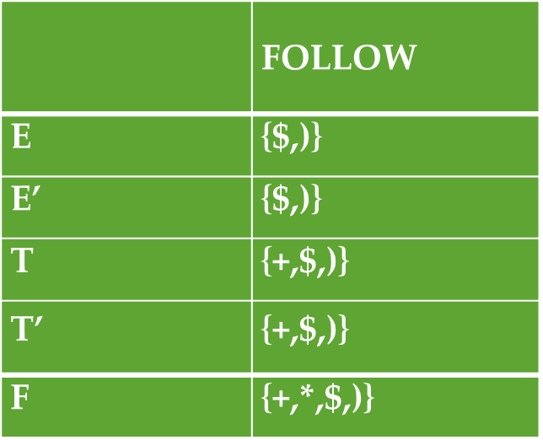
Error recovery in predictive parsing
Consider the grammar given below:
E ::= TE’
E’ ::= +TE’ | ε
T ::= FT’
T’ ::= *FT’ | ε
F ::= (E)|id
Insert ‘synch’ in FOLLOW symbol for all non terminals. ‘synch’ indicates resume the parsing.

Slide 66
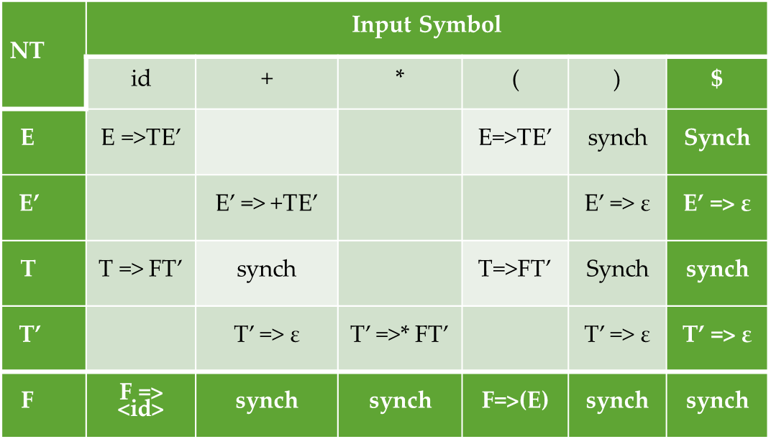
Error recovery in predictive parsing

Slide 67
Error recovery in predictive parsing
Stack | Input | Remarks
$E | id*+id$
$E | id*+id$
$E’ T | id*+id$
$E’ T’ F | id*+id$
$E’ T’ id | id*+id$
$E’ T’ | *+id$
$E’ T’ F* | *+id$
$E’ T’ F | +id$ | Error, M[F,+]=synch
$E’ T’ | +id$ | F has been popped.
$E’ | +id$
$E’ T+ | +id$
$E’ T | id$
$E’ T’ F | id$
$E’ T’ id | id$
$E’ T’ | $
$E’ | $
$ | $

Slide 68
Error Recovery in LR Parser
An LR parser will detect an error when it consults the parsing action table and find a blank or error entry. Errors are never detected by consulting the goto table.
An LR parser will detect an error as soon as there is no valid continuation for the portion of the input thus far scanned.
A canonical LR parser will not make even a single reduction before announcing the error.
SLR and LALR parsers may make several reductions before detecting an error, but they will never shift an erroneous input symbol onto the stack.

Slide 69
Error Recovery in LR Parser
Panic-mode Error Recovery
Scanning down the stack until a state s with a goto on a particular nonterminal A is found.
Zero or more input symbols are then discarded until a symbol a is found that can legitimately follow A.
The parser then stacks the state GOTO(s, A) and resumes normal parsing.
The situation might exist where there is more than one choice for the nonterminal A. Normally these would be nonterminals representing major program pieces, e.g. an expression, a statement, or a block.
For example, if A is the nonterminal stmt, a might be semicolon or }, which marks the end of a statement sequence.
By removing states from the stack, skipping over the input, and pushing GOTO(s, A) on the stack, the parser pretends that if has found an instance of A and resumes normal parsing.

Slide 70
Error Recovery in LR Parser
Phrase-level recovery
Each empty entry in the action table is marked with a specific error routine.
An error routine reflects the error that the user most likely will make in that case.
An error routine inserts the symbols into the stack or the input.

Slide 71
Faculty Video Links, Youtube & NPTEL Video Links and Online Courses Details
Youtube/other Video Links
https://nptel.ac.in/courses/106/105/106105190/
https://nptel.ac.in/courses/106/105/106105190/
https://www.youtube.com/watch?v=8LxnXjfOH8c&t=10s
https://nptel.ac.in/courses/106/105/106105190/

Slide 72
Daily Quiz
The best way to compare the different implementations of symbol table is to compare the time required to
add a new name
make an inquiry
add a new name and make an inquiry
None of these
Advantage of panic mode of error recovery is that
it is simple to implement
it never gets into an infinite loop
both (a) and (b)
none of these

Slide 73
Daily Quiz
The allocation which manages storage for all data objects at compile time:
Dynamic
Static
Heap
Stack
In which of the allocation scheme the data are managed at runtime
stack allocation
static allocation
heap allocation
none of the above

Slide 74
Daily Quiz
Which error recovery strategies guarantees not to go in infinite loop.
Global production
Panic mode
Phrase level recovery
Error production
Which of the following actions an operator precedence parser may take to recover from an error? a) Insert symbols onto the stack b) Delete symbols from the stack c) Inserting or deleting symbols from the input d) All of the mentioned

Slide 75
Daily Quiz
Uniform symbol table
a) Has all constants in the program b) Permanent table of rules in the form of patterns for matching with the uniform symbol table to discover syntactic structure c) Consists of full or partial list of the tokens as they appear in the program created by Lexical analysis and used for syntax analysis and interpretation d) A permanent table which has all key words and special symbols of the language in symbolic form
Access time of the symbol tables will be logarithmic, if it is implemented by
linear list
search tree
hash table
self-organizing list

Slide 76
Daily Quiz
Symbol table can be used for
checking type compatibility
suppressing duplication of error messages
storage allocation
None of the above
In case of symbol table, we need to be able to
Determine whether a given name is in the table
Add a new name to the table
Add new information for a given name
Delete a name or group of names from the table
(i), (ii), (iii) & (iv)
(ii), (iii) & (v)
(iii) & (v)
(i), (iii) & (iv)

Slide 77
Weekly Assignments-1
Discuss the various data structures used for symbol table with suitable example.
Write short note on
Scoping
Activation record
Backpatching
What is the role of symbol table?
Discuss different data structures used for symbol table.
Why run-time storage management is required?

Slide 78
Weekly Assignments-2
How simple stack implementation is implemented?
Discuss the issues in a programming language design that affects the storage management.
What are the three storage allocation strategies? Explain each in detail.
What are lexical phase errors, syntactic phase errors and semantic phase errors? Explain with suitable example.
Suggest methods for recovery of errors for lexical phase, syntactic phase and semantic phase.

Slide 79
MCQ
When is the type checking usually done?
a) During syntax directed translation
b) During lexical analysis
c) During code optimization
d) During syntax analysis
The term environment in programming language semantics is said as ____
a) Function that maps a name to value held there
b)Function that maps a name to storage location
c)The function that maps a storage location to the value held there
d) None

Slide 80
MCQ
By whom is the symbol table created? a) Compiler b) Interpreter c) Assembler d) None of the mentioned
The output of lexical analyzer is a) A set of regular expression b) Syntax tress c) Set of Token d) String of Characters

Slide 81
MCQ
Which is the permanent database in the general model of compiler
a) identifier table
b) literal table
c) terminal table
d) source code
The best way to compare the different implementations of symbol table is to compare the time required to
add a new name
make an inquiry
add a new name and make an inquiry
None of these

Slide 82
MCQ
Which of the following symbols table implementation is based on the property of locality of reference? a) Hash Table b) Search tree c) Self organizing list d) Linear list
When is the type checking usually done?
a) During syntax directed translation
b) During lexical analysis
c) During code optimization
d) During syntax analysis

Slide 83
MCQ
Which of these is not true about Symbol Table?
a) All the labels of the instructions are symbols b) Table has entry for symbol name address value c) Perform the processing of the assembler directives d) Created during pass 1
A compiler can check?
a) Logical Error b) Syntax Error c) Both Logical and Syntax Error d) Not Logical and Syntax Error

Slide 84
Glossary Questions
Q1. Define symbol table?
Q2. What is dynamic scoping?
Q3. What are the contents of activation record?
Q4. What is phrase level error recovery?
Q5. What is kernel and non-kernel items?
Define handle?
Q6. Which phases of compiler does use symbol table?

Slide 85
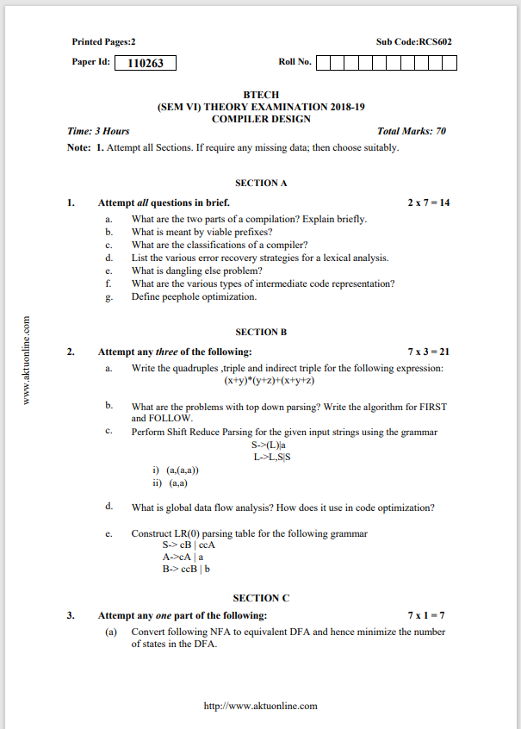
Old Question Paper

Slide 86
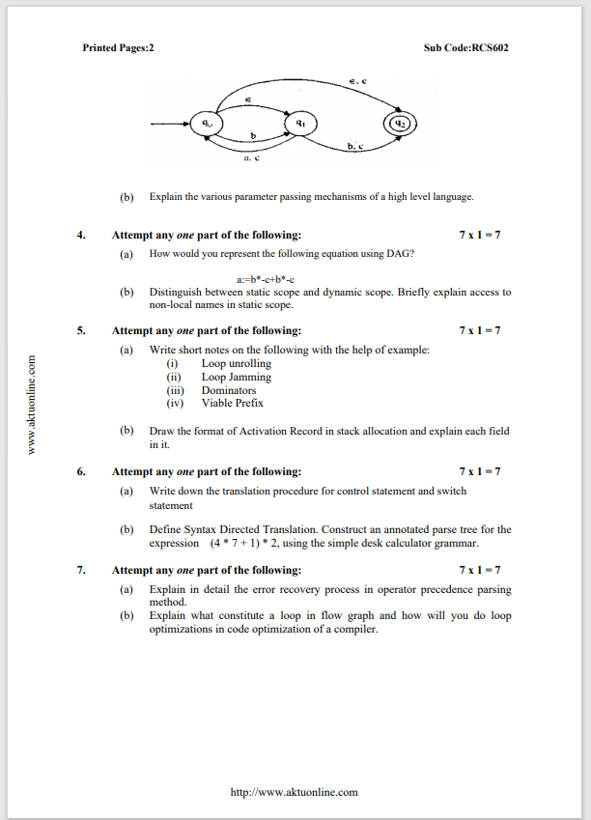
Old Question Paper

Slide 87
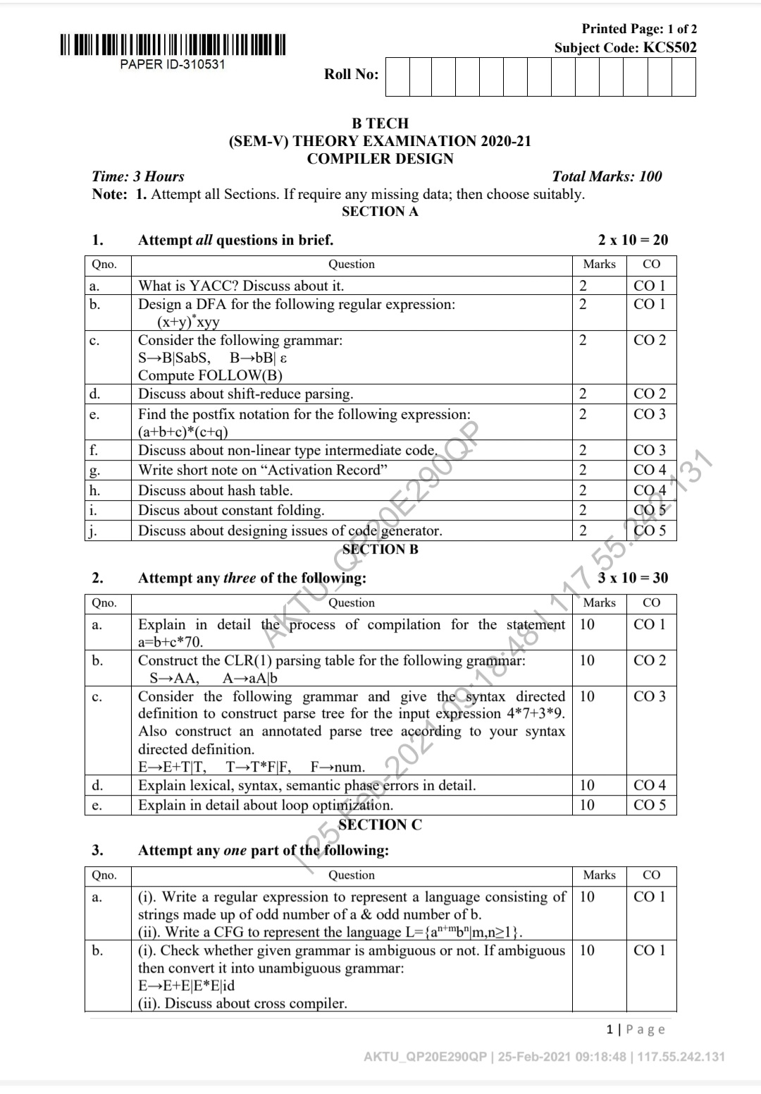
Old Question Paper

Slide 88
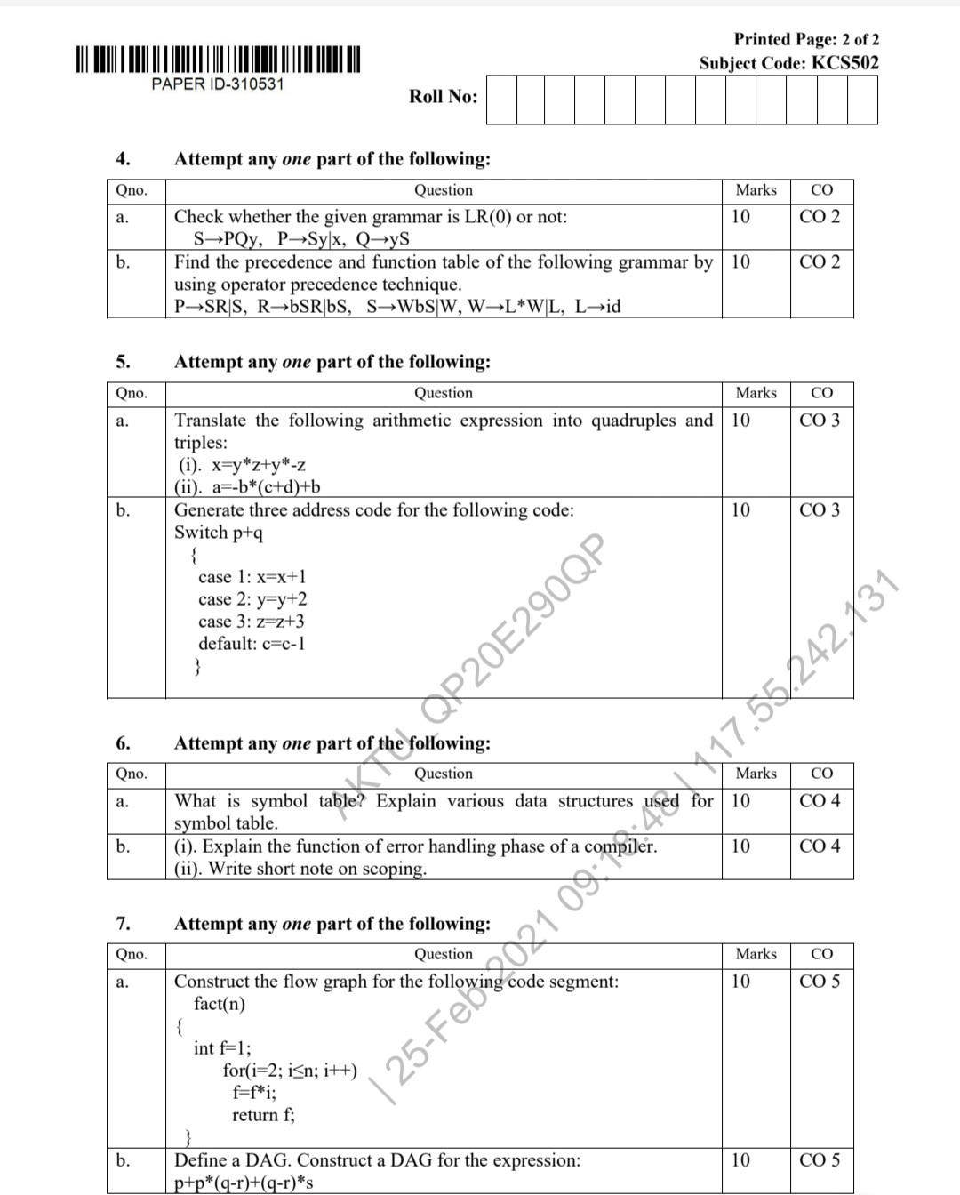
Old Question Paper

Slide 89
Expected Question for University Exam
How names can be looked up in the symbol table? Discuss.
How to subdivide a run-time memory into code and data areas. Explain
What are the different operations provided by symbol table?
What are the different error recovery strategies implemented in Compiler Design?
What are the attributes that shall be stored in the symbol table?
Write a short note on the following.
Lexical phase error ii. Syntactic phase error

Slide 90
Recap of Unit
The symbol tables - repository of all information within a compiler. All parts of a compiler communicate through these table and access the data-symbols. Symbol tables are also used to hold labels, constants, and types.
The logical address space is shared among the compiler, operating system and target machine for management and organization.
A hash table, or a hash map, is a data structure that associates keys with values ‘Open hashing’ is a key that is applied to hash table.
The nesting depth of a procedure is a number that is obtained by starting with a value of one for the main and adding one to it every time we go from an enclosing to an enclosed procedure.
Control stack is a run time stack which is used to keep track of the live procedure activations i.e. it is used to find out the procedures whose execution have not been completed.

Slide 91
References
K. Muneeswaran,Compiler Design,First Edition,Oxford University Press.
J.P. Bennet, “Introduction to Compiler Techniques”, Second Edition, Tata McGraw-Hill,2003.
Henk Alblas and Albert Nymeyer, “Practice and Principles of Compiler Building with C”, PHI, 2001.
Aho, Sethi & Ullman, "Compilers: Principles, Techniques and Tools”, Pearson Education
V Raghvan, “ Principles of Compiler Design”, TMH
Kenneth Louden,” Compiler Construction”, Cengage Learning.
Charles Fischer and Ricard LeBlanc,” Crafting a Compiler with C”, Pearson Education

Slide 92
Thank You

